Slide 1

Know Your Unknown Customer
Market Model for Legal Entities

Slide 2


Problem statement
Scope:
Identification of opportunities for new to bank companies where only public data is available
Improve customer experience for existing customers by differentiating them based on their common characteristics
Target audience:
Companies incorporated in local market (Romania), with focus on small and medium sized entities
Problem:
Significant amount of publicly available data not used to understand company profiles, risks and needs, especially for new to bank legal entities customers
Solution:
Use machine learning algorithms on publicly available data to obtain data driven insights for:
improved customer segmentation beyond the traditional segmentation by company size
asses risk of each company by predicting the change in its legal status
gain additional insights to identify targeted lending opportunities (segment of one)

Slide 3
WHY?
#Lending
DIGITALIZATION
Objective Decision Making
Process Efficiency
Lower Costs
#NPS Improvement
Portfolio/ Market structure
Number
Value

Slide 4
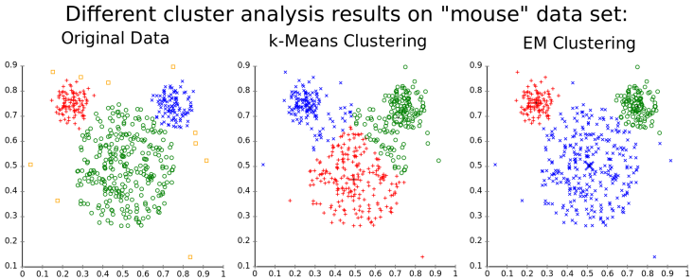
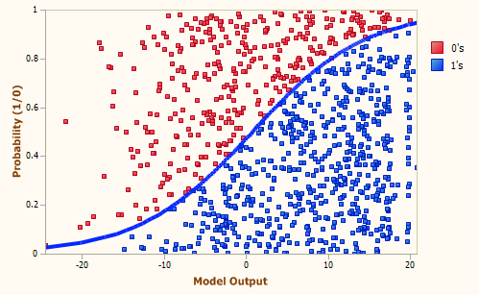
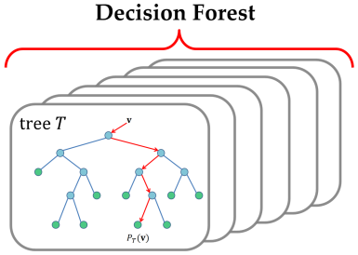
WHAT?
Models & algorithms
Segmentation:
For segmentation we want to predict homogenous customer segments based on their similar characteristics using unsupervised models (i.e. k-means)
Risk classification:
Supervised classification models to predict change in the legal status of the company (from Operating to Insolvency, Criminal Persecution etc translating in probability of default for the Bank)
Additional information:
Algorithms for calculating: industry position, potential headroom, eligible products and risk based pricing.

Slide 5
HOW: example of model applicability
PUBLICLY
AVAILABLE DATA
DATA
PROCESSING
MODELS &
ALGORITHMS
PRESENTATION
Client name: XYZ S.R.L.
Segment: Small Family Company/Niche Player/
Int’l Group etc
Risk Category: Low/Medium/Increased/High
Additional information:
Company Sales: EUR 5 Mio
Group Sales: EUR 50 Mio
Industry Position: Top Player
Potential Headroom: EUR 500.000
Eligible Products:
Overdraft – max. EUR 350.000, pricing 3.5%
Investment Loans – max. EUR 200.000, pricing 4.5%
Models:
Segmentation
(K-means)
Risk Category
(Regression, XGBoost, Random Forrest …)
EXAMPLE
Company Data
Company Data
normalized
Shareholder Data
Company Fiscal Data
Group Data
normalized
Financial Statements
Overdue State Debts
Market Data
(aggregated)
Insolvency Registry
Algorithms:
Industry Position
Potential Headroom (EUR)
Risk Based Pricing
Eligible products
Movables Registry
Macroeconomic
Data
Raw data sources
Normalized data

Slide 6
Model development
Compare model results for different algorithms, asses how the model generalize on new data, validate results
Try out various unsupervised models and then overfit a decision tree to understand the characteristics found
Data processing
Segmentation models
Classification models
Testing and validation
Deployment
Null treatment,
data quality,
feature development
Apply classification models to find the most relevant one

Slide 7
Data processing
Visualizations
Jun-19
Jul-19
Dec-19
Fine tuning and Deployment
Use Case
Roadmap
Segmentation models
Sep-19
Nov-19
Testing
and validation
Oct-19
Classification
models

Slide 8
Thank you!

